Slide 1

FAKE NEWS CLASSIFICATION & PREDICTION
DATA 606 - CAPSTONE PROJECT
Project By:
SUSHRUTH DT
SRIKEERTHI UPPERLA

Slide 2

Under the guidance of
Prof. Chaojie (Jay) Wang

Slide 3


Team Members
Sushruth DT
Srikeerthi Upperla

Slide 4
Contents of the Presentation
EDA
&
Preprocessing
Modeling
&
Evaluation
Web Application
Introduction

Slide 5
Introduction
Misleads
&
Manipulates
Distrust
in Media
Social
&
National Harm
Undermines the Democratic process
Affects Businesses
&
Society
Platform for harmful conspiracy theories & hate speech

Slide 6
Impact of Fake News
$650 Million
$39 Billion
Stock Market Losses and Volatility
1
6
Political Spend
& Brand Safety
$17 Billion / Yr
$3 Billion
Financial Misinformation in US alone
2
5
Online Platform Safety
$9.4 Billion
$9 Billion
Reputation Management
3
4
Public Health Misinformation – US alone

Slide 7
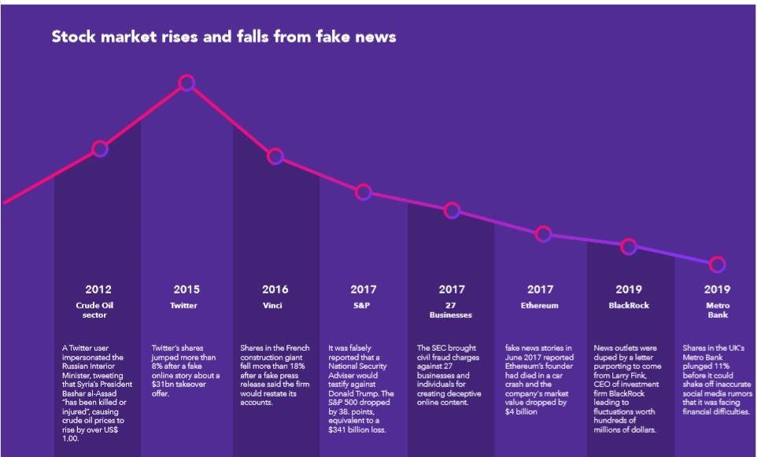


Slide 8
Why people create fake news?
1
Earn money
2
Get influence
3
Spread fear
4
Incite hatred

Slide 9
Teens & Parents, both worried about the spreading Fake News
1
2
3
4
Parents
Parents
Teens
Teens
Indicated they were concerned
that their teen would spread
misinformation
Said they'd like to learn
how to identify fake news.
“Somewhat” concerned about
mistakenly spreading
fake news
Said they'd like to learn
how to identify fake news.
63%
20%
50%
30%
Source: National Cyber Security Alliance.

Slide 10
Problem Statement
Facebook Engagement during elections
: Some popular US political fake news
960,000
567,000
“Pope Francis Shocks World, Endorses Donald Trump for President, Releases Statement”
"FBI Agent Suspected in Hillary Email Leaks Found
Dead in Apartment Murder-Suicide"
789,000
754,000
701,000
“Wikileaks CONFIRMS Hillary Sold Weapons to ISIS... Then Drops Another BOMBSHELL! “
"IT'S OVER: Hillary's ISIS Email Just Leaked & It’s Worse Than Anyone Could Have imagined"
"Just Read The Law: Hillary Is Disqualified From Holding Any Federal Office"

Slide 11
Solution
Develop UI to identify and classify fake news VS Real news
The plan is to carefully select features to identify fake posts/news.
Notes:
Solution is if there were any independent app/ , student can check correctness of news!!

Slide 12
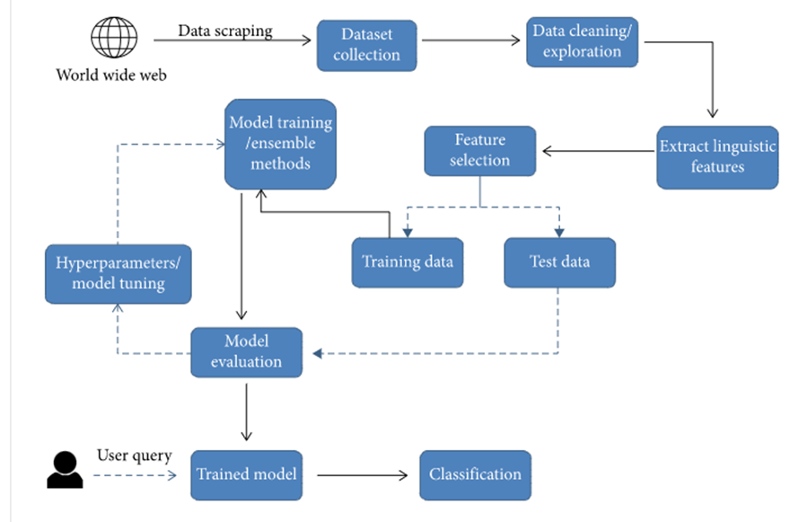
Project flow

Slide 13
About the Dataset
Columns:
Size: 123.81 MB
Shape: (20800, 5)
id: Unique id for a news article
title: The title of a news article
author: Author of the news article
text: The text of the article; could be incomplete
label: A label that marks the article as potentially unreliable
1: unreliable
0: reliable

Slide 14
How to spot fake news?
Ask the experts
Check the author
Read beyond
1
2
3

Slide 15
Research Questions
Concentration on:
title
author &
text from the dataset.
Title and Text
Fake news
Usage of repetitive jargon
Pattern
Highly used Keywords
Author
Who published the highest no. of Fake news?
Is there a pattern?
Predict if the following edition of the author would be fake.

Slide 16
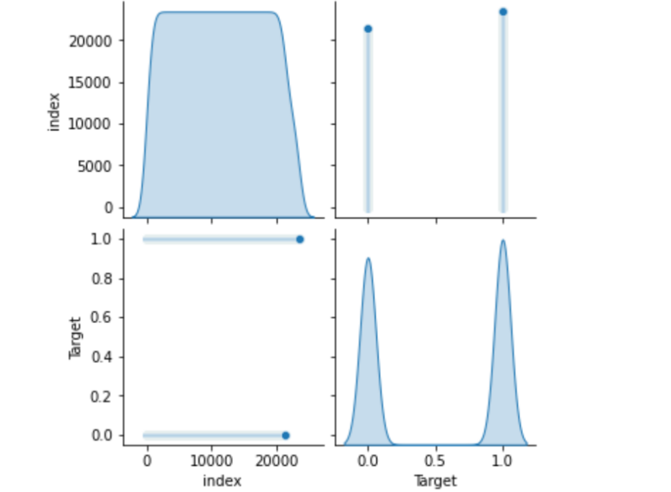
EDA : Chart 1 - Data Distribution
No Null values
Normally Distributed
No outliers
Data is clean

Slide 17
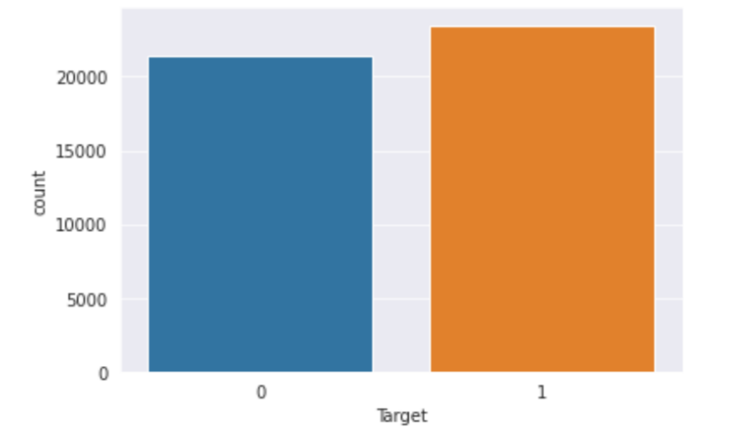
EDA : Chart 2- Countplot
Equal Distribution between Fake News and Real News.
No chance of Bias.

Slide 18
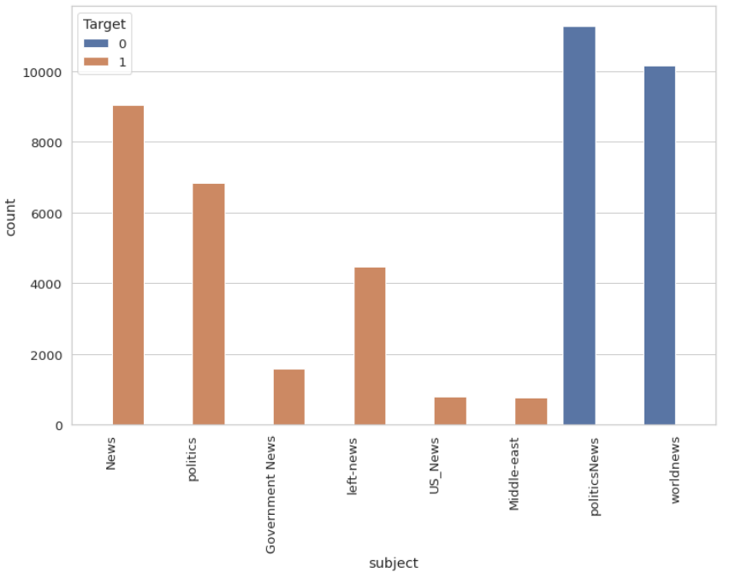
EDA : Chart 3 - Countplot
Top subjects of Fake News classified.
Lot of fake news is published with respect to Political News and World News.

Slide 19
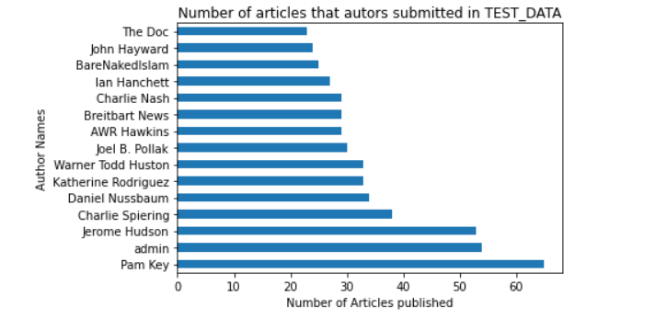
EDA : Chart 5 - Barplot

Slide 20
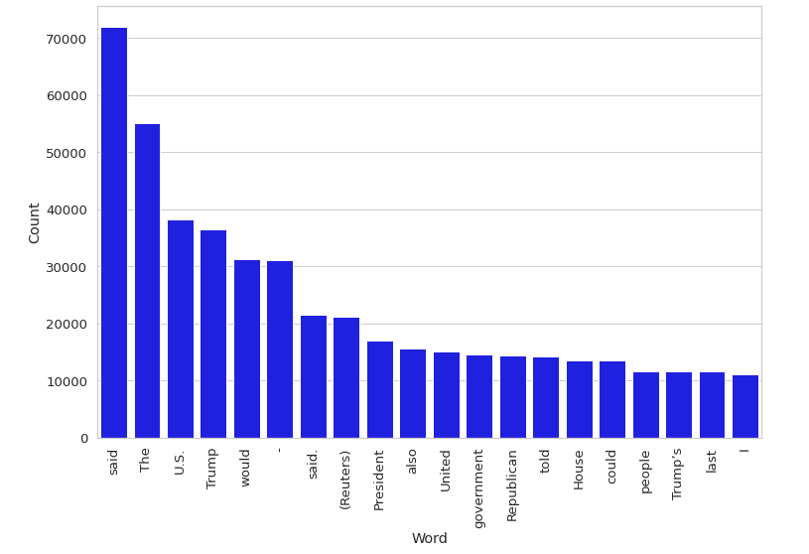
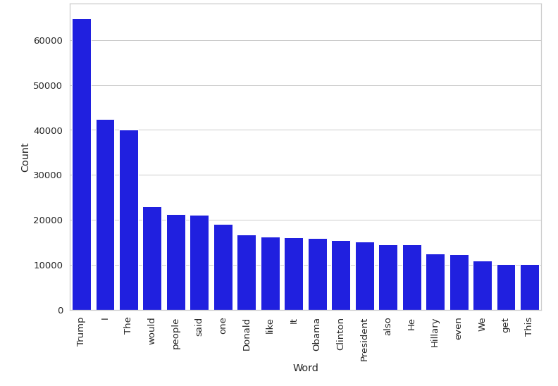
EDA : Chart 6 n-gram
Unigram for Real News
Unigram for Fake News
Notes:
1 : Fake

Slide 21
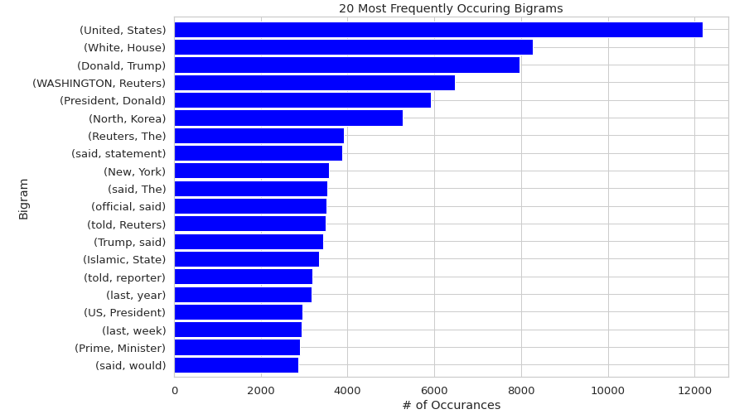
EDA : Chart 7 n-gram

Slide 22
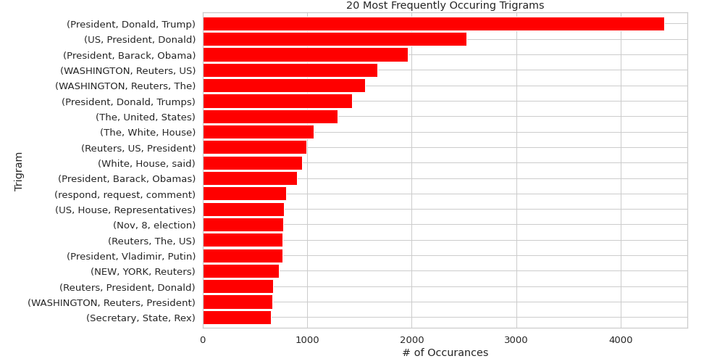
EDA : Chart 8 n-gram

Slide 23
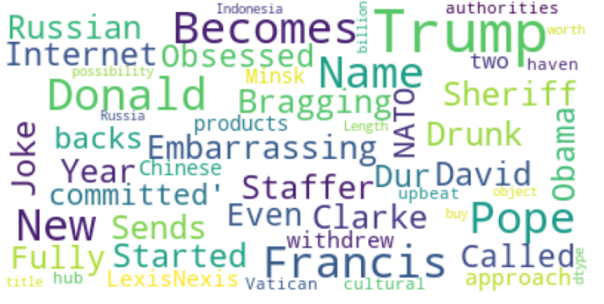

Chart 9 – Word Clouds
Word cloud after removing stop words : Title
Word cloud after removing stop words : Text

Slide 24
Modeling
01
Text Preprocessing
Cleaning, Stemming, Contraction Removal, Special Char Removal, Lemmatized, Tokenized
02
Count Vectorizer, TF-IDF
Vectorizing
Modeling
03
App Deployment
Streamlit based web app that
allows users to check the correctness of the news

Slide 25
Text Processing
Text Casing
Removed Stopped Words
Removed Punctuation
Removed URL/Website taxonomy
Word Tokenize
Lemmatize
Null and duplicate Check

Slide 26
Model Comparision
Logistic Regression
Randomn Forest
Decision Tree
Gradient Boost
Accuracy: 98.66%
Accuracy : 98.69%
Accuracy: 98.45%
Accuracy : 99.03%
Notes:
Table.

Slide 27
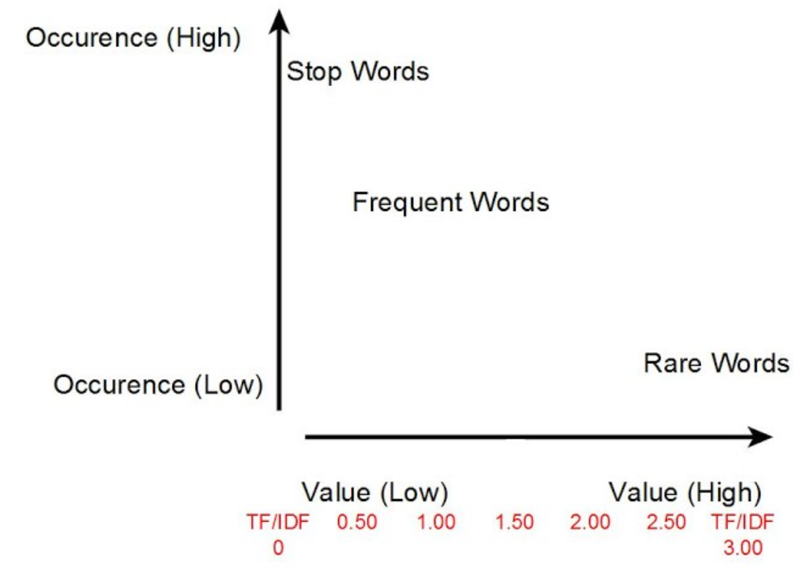
TF-IDF
TF-IDF vectors are related to one-hot encoded vectors, words that occur a lot but everywhere should be given very little weighting or significance.
We can think of this as words like the or and in the English language.
They don’t provide a large amount of value.

Slide 28
Model Comparision : TF-IDF Transformation
Logistic Regression
Randmon Forest
Decision Tree
Gradient Boost
Accuracy: 94.86%
Recall : 95%
F-1 Score : 95%
Precision : 95%
Accuracy : 95.09%
Recall : 94%
F-1 Score : 94%
Precision : 94%
Accuracy: 96.45%
Recall : 95%
F-1 Score : 95%
Precision : 95%
Accuracy : 97.43%
Recall : 96%
F-1 Score : 96%
Precision : 96%
Notes:
Table.

Slide 29

Deployment
Streamlit turns data scripts into shareable web apps in minutes.
Therefore, we utilized Streamlit to create an Interactive Web application.
By using Streamlit components, we created Buttons, Sliders, Text box, Activities etc., where users can input to classify News.
Steps Involved:
Created Model’s
Pickled and saved the models
Set up a streamlit instance on local machine
Leveraged “Session” to unwrap the model using “Model unwrap”
Passed the user input text to the model, for it to predict the dependent variable.

Slide 30
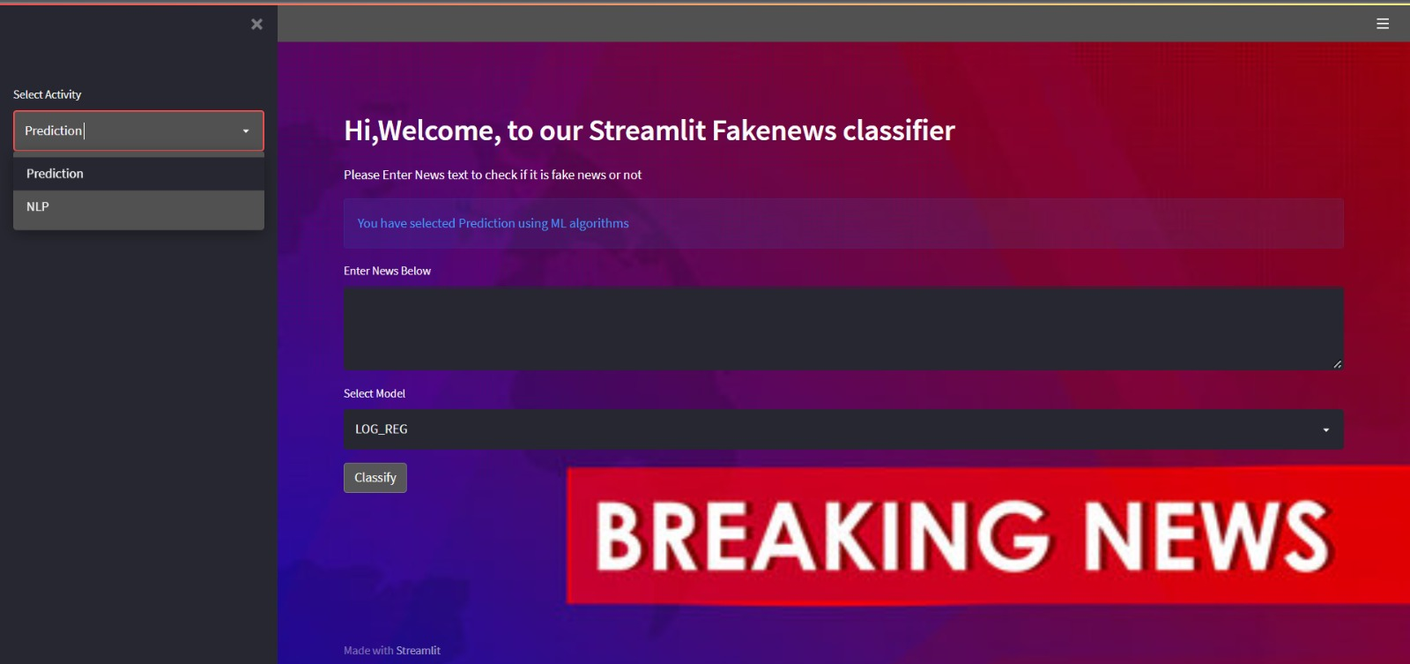
Sample Output : UI

Slide 31

Sample Output : Fake News

Slide 32
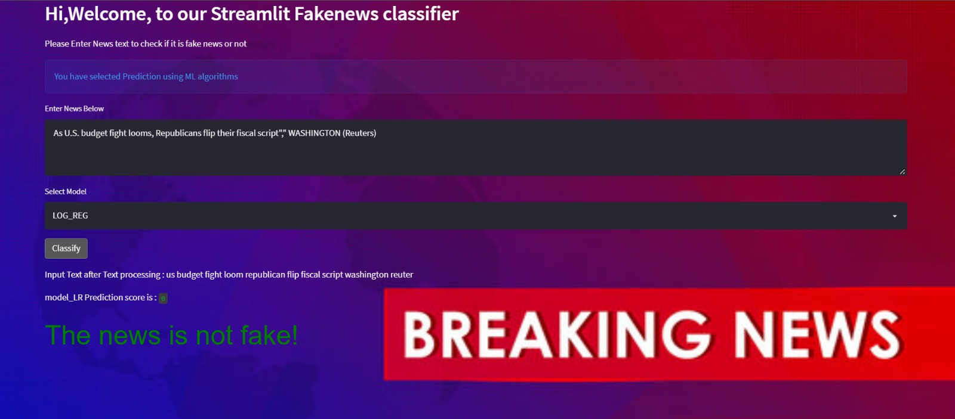
Sample Output : Real News

Slide 33

Challenges
Finding an unbiased dataset: Most of the datasets had more number of real news , very less fake news or vice-versa.
Faced String-vector issues when we implemented TF-IDF and Count Vectorizer, to overcome, we had to build a pipeline.
Choosing an Interactive platform to deploy our models. We investigated the pro’s and con’s of each and finally chose Streamlit.
Integrating our models to the UI after pickling.
Notes:
1. Finding an unbiased Data source: Train and test – merge – had more number of real news , very less fake news
Lot of issues with TF- IDF and Count Vectorizer – used to get issues like : string vector issues , had to put it in pipeline
Third , after pickling , integrating the UI to the model, had to create functions Streamlit was new. _ Choosing an interactive platform – pros and Cons and finally ended up streamlit.

Slide 34
References
https://towardsdatascience.com/fake-news-detection-with-machine-learning-using-python-3347d9899ad1
https://www.csustan.edu/sites/default/files/groups/University%20Honors%20Program/Journals/02_stahl.pdf
https://arxiv.org/pdf/1805.08751.pdf
Streamlit docs. Streamlit documentation. (n.d.). Retrieved May 17, 2022, from https://docs.streamlit.io/

